Slide 1

Evolution OF IDEAS: Slang
Soundtrack: “Ebonics” Big L 1999
Ad Campaign: Speak Out Against Ebonics, 1998 NY Times
Agenda:
Overview of the Class Thus Far
Demonstration of the Slang Map Process
Conversation about reading

Slide 2
Overview of Class Thus Far: Definition
Slang is a component of language that even the most accomplished linguists struggle to
define. Perhaps by not defining slang, we can approach a meaning that best describes it.
Contrary to vernacular or jargon, slang was not created for one specific purpose; rather, it is
multipurpose and highly situational such that there seems to be no real rhyme or reason as to
what truly constitutes slang. For this reason we must consider slang as something entirely
different from language intended for use amongst an entire populace. Slang is a relaxed yet creative language, that varies and evolves depending on the context of its use.

Slide 3
Overview of Class Thus Far: New Slang
Narn, or Narn Away : something far away; a great distance so far that one could travel to the mystical land of Narnia in the same amount of time. [borrowing, blending, and functional shift]
We started our process with a concept that we felt needed a slang term. Many of us
have classes that are ten minutes apart from each other but take more than ten minutes
to get to. These classes feel like they are in a mystical, unreachable location. There
aren’t many slang synonyms for “far away” that are in modern usage. To come up with a
word to fit this description, our team brainstormed places that hyperbolized the distance
and then shortened it to create a simple word that rolls off the tongue.

Slide 4
Overview of Class Thus Far: New Slang
(to) Twix, Twixin’ [functional shift, affixation, and shortening]
Definition (v): Being unable to decide between two or more options; unable to make a clear choice or intentional avoidance of a choice; actively indecisive.
(a) Twix
Definition (n): an individual that is often unable to decide, one that wavers from decision to decision.
Examples:
He can’t decide what party he’s gonna go to. He’s twixin’.
Hillary Clinton is such a twix; she always goes back and forth between sides.

Slide 5
Overview of Class Thus Far: New Slang
SKYV (skiv) noun. Someone Killing Your Vibe; one who intentionally or
unintentionally disrupts the flow of conversation in order to have their opinions heard, often without contributing anything meaningful.
acronym as a form of shortening

Slide 6
Overview of Class Thus Far: Slang Template
Alternative Spelling
Tone
Consent (REQUIRED)
Race/Gender (If Apparent)
Population: people who appear to be students on Purdue’s Campus

Slide 7

Discussion: African American Vernacular English….A Short History
William Labov, late 1960s and the rise of sociolinguistics.
Famous Publications:
“The Logic of Nonstandard English”
Language in the Inner City

Slide 8
Discussion: African American Vernacular English….A Short History
American Slavery (1607-1865)
Heterogeneous African Languages
Peer Education
Slave Code (1705)
Prohibition of Slave Education

Slide 9
Discussion: African American Vernacular English….A Short History
Heterogeneous African Languages
Jamestown colony, Virginia (1607), 20 Africans indentured.
1750: blacks represented 3 percent of the population in New England, 7 percent of the population in the Middle colonies, but nearly 40 percent in the plantation economy of the South.
1793 invention of the cotton gin: fueled the development of new states: (Alabama, Arkansas, Louisiana, Mississippi, Missouri, Ohio and Texas)
Slave population increases from 700,000 in 1790 to 4,000,000 in 1860.

Slide 10
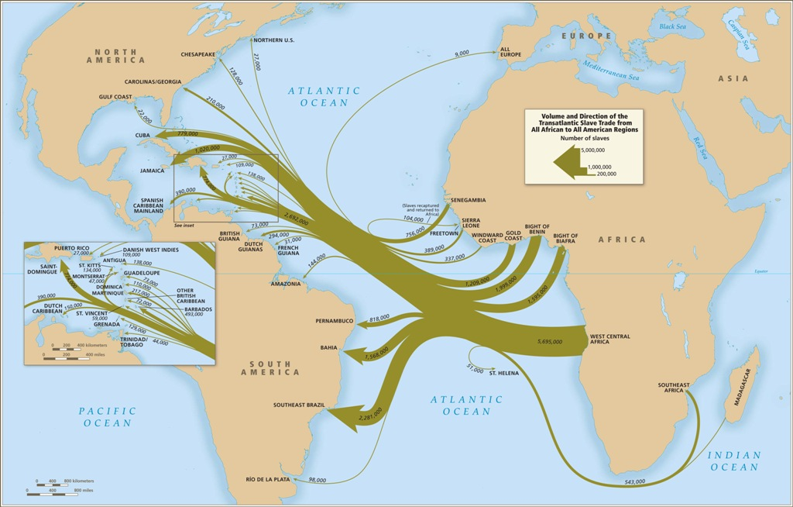
Discussion: African American Vernacular English….A Short History
Heterogeneous African Languages
Caribbean
Africa
West Central: Ivory Coast

Slide 11
Discussion: African American Vernacular English….A Short History
Peer Education
After the first generation, contrary to accepted dogma, most new Negroes learned the local language not from Englishmen but from other slaves, a fact which reinforced the distinctiveness of the dialect.
Pidgin: blend
Creole: birth

Slide 12
Discussion: African American Vernacular English….A Short History
Slave Code (1705)
Whites feeling threatened and wanting to ensure their economic and social dominance, passed increasingly hard laws restricting the rights of blacks, stipulating their status as property for life, and prescribing draconian punishments for them.
Whipping, Maiming, Branding, Ear Nailing, Castration
These laws erected and reinforced socio-psychological barriers between blacks and whites, leading to the crystallization of a black identity, expressed through a distinctive vernacular.

Slide 13
Discussion: African American Vernacular English….A Short History
Prohibition of Slave Education
South Carolina passed the first laws prohibiting slave education in 1740.
No limitations on reading or drawing, but it became illegal to teach slaves to write.
Fears over the spread of abolitionist materials and plans for slave rebellions (Nat Turner)

Slide 14
Rickford on the Ebonics Controversy
What information did you glean about the Ebonics controversy? How do you view the controversy?
When
Where
The Reported Purpose
The Assumed Purpose
Controversy
Your thoughts/Experiences?

Slide 15
Rickford’s Choice of Spoken Soul
Why do you think Rickford uses the term "Spoken Soul" instead of one of the more common terms for African American Vernacular English?
What is the meaning behind the term?
How does African American slang reflect African American culture?
What about appropriation?

Slide 16
Grossman & Tucker, Sexism and Slang
What is the assumption that the article establishes in the first couple of pages?
What evidence does it show to establish this assumption?
What do you think about this assumption? Consistent with your experience?

Slide 17
Grossman & Tucker, Sexism and Slang
What is the argument of the study?
Describe the methods?
Do you agree with the argument? What about the methods?

